Slide 1
DEVOPS FOUNDATION
Prepared by:
Akshiv Rajendran ©
Cloud DevOps Corporate Trainer

Slide 2
DevOps Foundation Exam
DevOps Foundation Exam accredited by DevOps Institute
40 MCQs
60 minutes
65% is passing
with Digital badge

Slide 3
Lecture 1 Exploring DevOps
Lecture 2 Core DevOps Principles
Lecture 3 Key DevOps Practices
Lecture 4 Business and Technology Frameworks
Lecture 5 Culture, Behaviors and Operating Models
Lecture 6 Automation & Architecting DevOps Tool chains
Lecture 7 Measurement, Metrics & Reporting
Lecture 8 Sharing, Shadowing & Evolving

Slide 4
Exploring DevOps
This fulfilled the gap in between Dev & Ops team, or in the other words, DevOps avoided the conflict between Dev & Ops team by combining it together In other words, DevOps is a Philosophy of the efficient development, deployment and operation of the highest quality software possible. It is a combination of Culture, Automation & Measurement.
==> Plan ==> Code ==> Build ==> Test ==> Release ==> Operate ==> Monitor back to ==> Plan

Slide 5
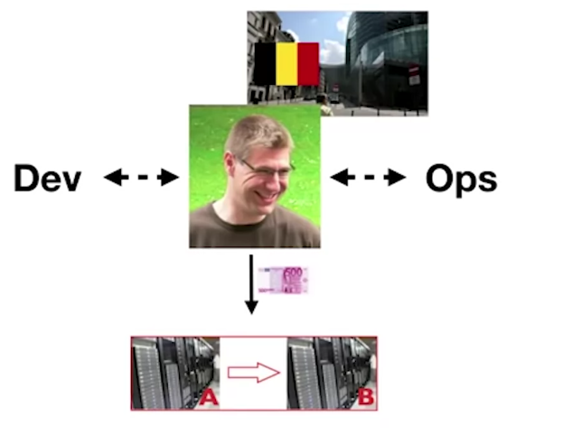
The History

Slide 6
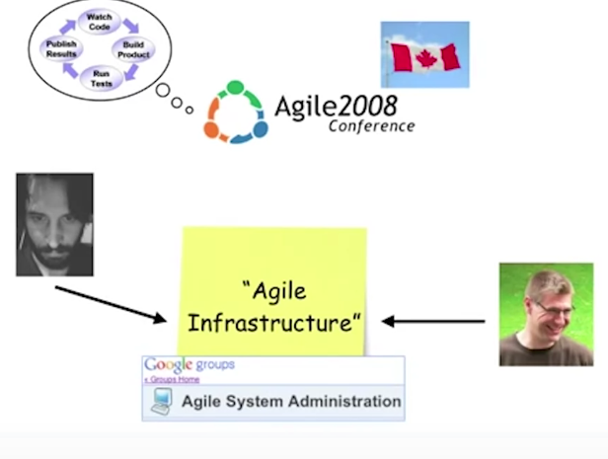

Slide 7
Why Is The History Important?
It reminds us that DevOps is…
From practitioner, by practitioners (not from any vendors or sales)
Not a product, specification, job title (doesn't belongs to specific category or company)
An experience-based movement
Decentralized and open to all

Slide 8
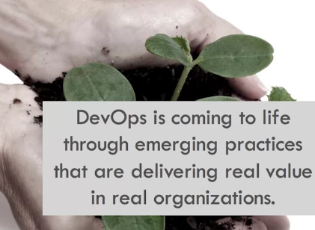
What DevOps Is NOT
A title
A separate team
A tool
Only culture
Only automation

Slide 9
Why DevOps Is Important Now:
More Organizations are migrating to cloud
Agile software development and cloud infrastructure is increasing
IT can no longer operate in a silo culture
Consumer have "app" mentalities and expectations
There is more data available to the business
To meet these changing conditions, IT must adapt its culture, practices and automation to be more "continuous", to shorten and accelerate the time to value for the business.

Slide 10
DevOps Goals:
Smaller, more frequent releases
Reduced effort and risks
Reduced cost of product iterations & delays
A culture of communication and collaboration
Consistency and speed through automation

Slide 11
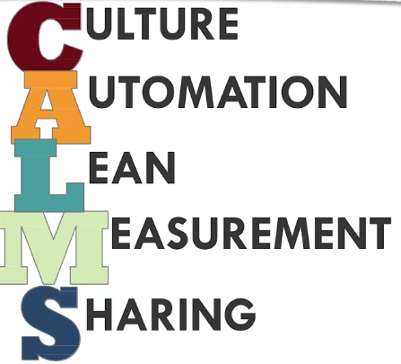
DevOps Value

Slide 12
More than anything else, DevOps is a cultural movement based on human and technical interactions to improve relationships and results.
Culture - “These are the beliefs, values behaviors of a group of people, and a company's culture is the same. It's the vision, values, beliefs and habits of the company“
Automation - “The technique, methods, or system of operating or controlling a process by highly automatic means, as by electronic devices, reducing human intervention to a minimum, it is important to DevOps because it helps your development, deployment and operations pipeline move faster"
Lean
Measurement/Metrics - "These should be used to help enhance the efficiency of your development and deployment process, some of the important metrics.
1. Frequency of deployments,
2. Mean time to Recovery [MTTR] (is the average amount of time it takes you to resolve problems with your production environment),
3. Mean time to discovery [MTTD],
4. System Availability (know the availability of your systems),
5. Service Performance,
6. Customer Complaints,
7. Lead time (Time in between Feature Requested to feature Released"
Sharing

Slide 13
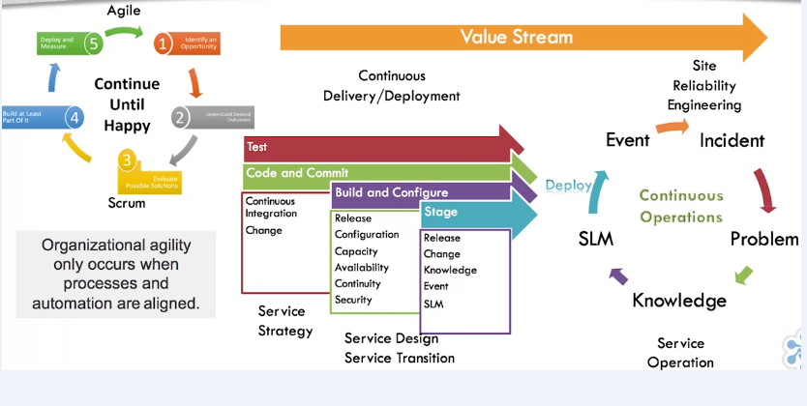
IT is a System of System

Slide 14
Dev includes all the people involved in developing software products and services including Architects, product managers, project managers, QA testers and analysts, etc.
Ops includes all the people involved in delivering and managing software products and services including Information security professionals, system engineers, system administrators, IT operation engineers, release engineers, Database Administrators (DBAs), network engineers, etc.

Slide 15
Why does DevOps matters?
Business wants to move quickly as we all know time is money
History:
Going back like waterfall method, works under linear activity where one activity can't begin until the previous activity is complete, in this approach make that customer feedback is delayed until the project is complete, we have here limited release windows because we need to fix all the bugs each time one by one.
Agile/Lean DevOps, the wait time reduces as we can simultaneously do activities and this reduces wait time.

Slide 16
DevOps improves Throughput and Stability
According to the 2017 state of DevOps Report, high-performing organizations have:
46 times more frequent code deployments
440 times faster lead time from commit to deploy
96 times faster mean time to recover from downtime
5 times lower change failure rate

Slide 17
Now this were accomplished by practicing
version control
continuous integration
continuous delivery
automated testing
Another consideration is that organizations are introducing more sophisticated monitoring early in the development cycles.

Slide 18
The IT Challenge
DevOps must continuously deliver outcomes by bridging and improving almost every aspect of IT.
Internal IT challenges:
IT must go faster, faster, faster without risking quality
Prior investments aren't delivering end to end value
Agile SW development is good but isn't delivering full value
ITSM (IT service management) processes are good but aren't delivering full value
New automation is good but isn't delivering full value
IT's silo culture is constraining the value stream
IT no longer needs to align or integrate with the business, IT IS the business

Slide 19
what Is The Drawbacks of Silos In Business?
It creates a self-fulfilling prophecy adopted by departments, as each department cares only about their success and not the organization's success as a whole.
It will lead to inefficiency at the organizational level and may reduce the organization's potential to achieve their goals.

Slide 20
The wall of Confusion
Dev wants change
Ops wants stability
Due to this 2 different goals, we always facing some confusions when they run separately

Slide 21
Top 5 Predictors of IT performance:
DevOps helps IT organizations become high performing
1. Peer-reviewed change approval process
2.Version control for all production artifacts (when a changes failed it's easy to pin-point and move back to the running state code that reduced the time to recover)
3.Proactive monitoring (diagnose and resolve problems faster, and have high degree of accountability)
4. High-trust organizational culture
5. win-win relationship between Dev & Ops

Slide 22
2. Core DevOps Principles
The Three ways
The Theory of Constraints
Chaos Engineering
Learning Organizations
The Three Ways
The First Way (Flow) = Understand and increase the flow of work (left {dev} to right {ops}), [the goal is to have quick and fast flow]

Slide 23
Theory of Constraints
A methodology for identifying the most important limiting factor (i.e., constraint) that stands in the way of achieving a goal and then systematically improving that constraint until it is no longer the limiting factor.
Every process has at least one constraint or bottleneck that affects its ability to consistently meet its goal

Slide 24
Common Constraints:
Development delays
Environment creation (test, staging, production, etc.,)
Code deployment (delayed due to number of dependencies and other reasons)
Security or QA assessments (3rd party tools may delays)
Complex or bureaucratic processes / Overly tight architecture

Slide 25
Second Way (Feedback)
The Second Way (Feedback) = Create short feedback loops that enable continuous improvement (right {ops} to left {dev})
Understand and respond to the needs of all customers - both internal and external [the goal is to shorten and amplify right to left feedback loops so necessary corrections can be continually made; this helps us to protect & correct our project on timely basis and provide better performance for our customers]

Slide 26
Third Way (Continuous Experimentation & Learning)
The Third Way (Continuous Experimentation & Learning)
Create a culture that fosters: -> Experimentations, taking risks and learning from failure,-> Understanding that repetition and practice is the prerequisite to mastery
Allocate time for the improvement of daily work
Create rituals that reward the team for taking risks
Introduce faults into the system to increase resilience
Plan time for safe experimentation and innovation (hackathons)

Slide 27
which leads us to Chaos Engineering
Chaos Engineering
The 'Simian Army' concept was first adopted by Netflix as a service that randomly terminates a production instance
Response to attacks helps to build competencies to recover the production environment from inevitable
["Chaos Monkey is a tool that randomly disables our production instances to make sure we can survive this common type of failure without any customer impact. The name comes from the idea of unleashing a wild monkey with a weapon in your data center (or cloud region) to randomly shoot down instances and chew through cables -- all the while we continue serving our customers without interruption. By running Chaos Monkey in the middle of the business day, in a carefully monitored environment with engineers standing by to address any problems, we can still learn the lessons about the weaknesses of our system, and build automatic recovery mechanisms to deal with them.
So next time an instance fails at 3 am on a Sunday, we won't even notice" - Netflix]

Slide 28
Learning Culture:
Encourage daily learning and knowledge sharing
Create training and skills-based education plans
Incorporate learning into processes
Use technology to accelerate learning
Make work educational through experimentation, problem solving and demonstrations
Allow and use mistakes as sources of learning
Make the results of learning visible

Slide 29
3. Key DevOps Practices
Continuous:
Testing
Integration
Delivery
Deployment

Slide 30
Continuous Testing:
It is the process of executing automated tests as part of the deployment pipeline to obtain immediate feedback on the business risks associated with a software release candidate.
Functional
Unit tests
API
Integration
System testing
Non-Functional
Performance
Security
Compliance
Capacity

Slide 31
Some of the Testing's are:
Test driven development (TDD)
Performance testing
End-to-End use case testing
Security testing
Manual testing
Canary & Blue/Green deployments

Slide 32
Continuous Integration:
CI is a development practice that required developers to commit code into a shared repository (master) at least daily.
Each check-in is validated by
An automated build
Automated unit, integration and acceptance tests
Requires version control repositories and CI servers to collect, build and test committed code together
Runs on production-like environments
Allows for early detection and quick remediation of errors from code changes before moving to production
Reduce merge conflicts

Slide 33
Continuous Delivery:
CD is a methodology that focuses on making sure software is always in a releasable state throughout its lifecycle.
Takes CI to the next level
Provides fast, automated feedback on a system's production-readiness
Prioritizes keeping software releasable/deployable over working on new features
Reduces the cost, time, and risk of delivering incremental changes
Relies on a deployment pipeline that enables push-button deployments on demand

Slide 34
Continuous Delivery & Continuous Deployment:
If the trigger towards production is Manual then it is Continuous Delivery, and if that is Automatic trigger towards the production server it is Continuous Deployment. According to project this will be decided.
[***Show the connection between Local server - cloud - Github - Jenkins using web hooks push a sample code]

Slide 35
Site Reliability Engineering:
"What happens when a software engineer is tasked with what used to be called operations" Ben Treynor, Google.
Goals are to create ultra-scalable and highly reliable software systems
50% of their time doing "ops" related work such as issues, on-call, and manual intervention
50% of their time on development tasks such as new features, scaling or automation.

Slide 36
Resilience Engineering:
They looks at how the organization functions as a whole
Take an aggressive, blameless and systemic view post incident
Consider both human and technical elements

Slide 37
DevSecOps:
The purpose and intent of DevSecOps is to build on the mindset that "everyone is responsible for security" with the goal of safely distributing security decisions at speed and scale to those who hold the highest level of contact without sacrificing the safety required
Introduces security as code
Leverages automation for resilience, testing, detection and audit
Breaks the security constraint
[For every 100 developers, there are 10 IT operations people and 1 security person]

Slide 38
ChatOps:
It is a communication system that allows teams to collaborate and manage many aspects of their infrastructure, code, and data from a chat room. It is great for synchronous communication, regardless of where people are, problem-solving and creating a shared history, as communications are searchable.
Now care must be taken to ensure information that needs to be kept secure, and also that information that is relevant to deployments or best practices gets moved to more permanent locations, such as knowledge bases, wikis, or Google Docs.

Slide 39
Kanban:
Kanban is a method of work that pulls the flow of work through a process at a manageable pace.
In Japanese, Kan means visual and ban means board.
So Kanban is basically a pull system. Teams pull work only when they are ready for it, in an effort to prevent overburdening of teams.
Visualizes and manages workflow
Pulls work for teams when they are ready for it
Enables people to work collaboratively to improve flow
Measures team velocity (quantity of work done in an iteration)
Reduces idle time and waste in a process
Makes work visible
Makes policies explicit
[*** show with Jira Software for Kanban]

Slide 40
4. Business & Technology Frameworks
DevOps cannot stand alone, Successful DevOps relies on the adoption and integration of multiple frameworks and methodologies, DevOps isn't the framework or methodology all in itself.
DevOps adopts and leverages multiple frameworks and methodologies such as Agile, Lean and IT Service Management.
DevOps applies lean principles such as increasing flow and reducing waste to the IT value stream.
DevOps has benefited tremendously from the work Agile community has done, showing how small teams operating with high trust, small batch sizes with small or more frequent software releases can dramatically increase productivity of development organizations.

Slide 41
Agile:
The Agile methodology is a way to manage a project by breaking it up into several phases. It involves constant collaboration with stakeholders and continuous improvement at every stage. Once the work begins, teams cycle through a process of planning, executing, and evaluating.

Slide 42
Scrum:
Scrum is a simple framework for effective team collaboration on complex projects. Scrum provides a small set of rules that create "just enough" structure for teams to be able to focus their innovation on solving what might otherwise be an insurmountable challenge. Scrum is not a process or a technique for building products. It increases the ability to release more frequently.

Slide 43
Scaled Agile Framework (SAFe):
The scaled Agile Framework (SAFe) is a proven, publicly available framework for applying Lean-Agile principles and practices at enterprise scale.
This can be applied to organizations with a large number of practitioners and teams.

Slide 44
How to increase Agility = by DevOps:
Breaking down silos
Improving constraints
Taking a unified approach to system engineering
Applying agile principles to both Dev & Ops
Sharing knowledge, skills, experience and data
Recognizing the criticality of automation
Deploying faster with fewer error
DevOps extends agile principles beyond the boundaries of the software to the entire delivered service across the organization.

Slide 45
IT Service Management:
It is the implementation and management of quality IT services that meet the needs of the business.
This provides guidance and structure to processes such as Change, Configuration, Release, Incident and Problem Management.
ITSM processes the entire service lifecycle from strategy, design, transition, operations, continual improvement and value creation.
DevOps needs ITSM practices to meet the goal of deploying faster changes without causing disruption.

Slide 46
IT Infrastructure Library (ITIL):
ITIL or IT Infrastructure Libraries is the most widely accepted approach to IT Service Management.
ITIL and ITSM remain the basic codifications of the processes that underpin IT Operations.
And they actually describe many of the capabilities needed for IT operations to support a DevOps style work stream.
Organizations that have adopted ITIL are finding that they can improve flow by applying Agile and lean principles to ITIL processes' improvement.

Slide 47
ITSM process models support DevOps and Continuous Delivery by:
Predefined procedures
Steps to be taken
Chronological order and dependencies
Responsibilities
Timescales and thresholds
Escalation procedures
Define steps for handling specific types of transaction
Ensure a defined path or timeline is followed
Can be automated

Slide 48
Lean:
DevOps has its roots in the lean manufacturing world. Lean methodology is a way of optimizing the people, resources, effort, and energy of your organization toward creating value for the customer.
It is based on two guiding tenets, continuous improvement and respect for people.
It is a systematic approach to identifying and eliminating waste in processes to deliver more value to customers with fewer resources.
The lean methodology seeks to optimize workflow, minimize inventory, reduce lead times, and engage and empower employees at all levels.

Slide 49
Improvement Kata:
A kata is any structured way of thinking and acting that you practice until the pattern becomes a habit.
The improvement kata is a 4 step process that focuses on learning and improving work. It considers the organization's long-term vision or direction.
P = Plan
D = Do
C = Check
A = Act
1.Understand the long-term vision of direction
2. Grasp the current condition
3. Establish the next target condition
4. PDCA and experiment toward the target condition

Slide 50
Safety Culture:
A safety culture in DevOps is about both psychological safety and rewarding the right behaviors. It's about being fearless, about reporting problems. Systemic safety, using techniques and tools to prevent, predict the remediate failure.

Slide 51
Learning Organizations:
Have a commitment to learning
Improvement requires learning something new
Not learning creates cultural debt
Management commitment is essential
Organizations that don't learn are less likely to be able to compete long term. It may experience high and expensive staff turnover.

Slide 52
Continuous Funding:
Traditional funding happens on annual cycles
Agile funding can be:
Fixed cost or continuous
Frequently reviewed
Product/Team based funding
Venture funding
Focus on measuring return

Slide 53
5. Culture, Behaviors & Operating Models
Defining culture
Behavioral Models
Organizational Models
Target Operating Models

Slide 54
Characteristics of a DevOps culture:
Shared vision, goals and incentives
Open, honest, two-way communication
Collaboration
Pride of workmanship
Respect
Trust
Transparency
Continuous improvement
Experimentation
Intelligent risk taking
Learning and practicing
Data-driven
Safe
Reflection
Recognition
Organizational culture is one of the strongest predictors of both IT performance and overall performance of the organization.

Slide 55
Shifting Thoughts and Behaviors:
From | To
IT focus (inside-out) | Customer focus (outside-in)
Silos | Cross-functional teams
Command and control | Collaborative
Task-oriented | Outcome-oriented
Blame | Responsibility
Reactive | Proactive
Content | Courageous
Resistant | Flexible
Low trust | High trust
Real culture change takes time. It must be incremental and performed at a realistic pace

Slide 56
Culture and the Flow of Information:
Pathological (power-oriented) | Bureaucratic (Rule-oriented) | Generative (performance-oriented)
Information is hidden | Information may be ignored | Information is actively sought
Messengers are 'shot' | Messengers are isolated | Messengers are trained
Responsibilities are shirked | Responsibilities is compartmentalized | Responsibilities are shared
Bridging is discouraged | Bridging is allowed but discouraged | Bridging is rewarded
Failure is covered up | Organization is just and merciful | Failure causes enquiry
Novelty is crushed | Novelty created problems | Novelty is implemented
High-trust organizations encourage good information flow, cross-functional collaboration, shared responsibilities, learning from failures and new ideas.

Slide 57
Culture change is never easy:
You can't change people; they can only change themselves
Change almost always takes longer and costs more than expected
People who participate in what and how to change decision are far more likely to accept change.

Slide 58
People adapt to Change at Different Paces:
Adoption means that a person does something differently than before
1. Innovators (2.5%) =These are people who want to be first to try the innovation. They're venturesome, and they're interested in new ideas. These people are very willing to take risks and are often the first to develop new ideas themselves.
2. Early Adopters (13.5%) =These are people who represent opinion leaders. They enjoy leadership roles and embrace change opportunities. They are usually already aware of the need to change and so are very comfortable adopting new ideas. Strategies to appeal to this group of the population include how-to manuals, information sheets on implementation and social media where implementation ideas are shared. This group do not generally need information to convince them to change.
3. Early Majority (34%) =These people are really leaders, but they do adopt new ideas before the average person. That said, they typically need to see evidence that the innovation works before they're willing to adopt it. So strategies to appeal to this group of the population include success stories and evidence of the innovation's effectiveness.
4. Late Majority (34%) = These people are skeptical of change and will only adopt an innovation after it has been tried by the majority. So strategies to appeal to this population group include information on how many other people have tried the innovation and have adopted it successfully.
5. Conservatives (16%) = These people are bound by tradition and generally very conservative. They are very skeptical of change, and they are the hardest group to bring on board. Strategies to appeal to this group of the population include statistics, fear appeals and pressure

Slide 59
Communication is Critical:
A DevOps culture requires timely and effective communication
Shared tools facilitate timely and meaningful communication
Chat platforms
Task managers
Social tools
Alert management tools
Knowledge sharing platforms

Slide 60
Encourage Collaborative Relationships:
Collaboration involves people jointly working with others towards a common goal. In a collaborative environment, each person's contribution is valued.
Collaboration
Is voluntary (ideally)
Involves sharing
Responsibility for outcomes
Resources
Requires cooperation, respect and trust
Requires participation
Providing feedback
Identifying and solving problems
Learning and sharing knowledge and expertise
Sharing and even swapping responsibilities
Making and keeping realistic commitments

Slide 61
Avoid Change Fatigue:
Change fatigue is a general sense of apathy or passive resignation towards organizational changes by individuals or teams.
View resistance to change as normal
Listen, empathize
Communicate the big picture
Explain the reason for this change
Show how changes are connected
Tie changes to business strategies and goals
Ensure each change initiative has an intended outcome
Empower people to contribute
Celebrate (even if only small) successes
Create visible feedback and improvement loops
The amount of change fatigue that people experience is directly impacted by the way change is managed.

Slide 62
Empower New Behaviors:
Improve communication and collaboration practices and shared tools
Create a common vocabulary
Job shadowing
Cross-skilling
Immersion experiences
Team building
Communities of practice
Internal DevOps Days
Game days (hackathons)
Social-media style idea sharing and problem solving.
sharing between peers, organizations and industries is a crucial factor in the growth and acceptance of DevOps.

Slide 63
Make Structural Changes:
1. Operating model
Simplify structure, accountability
Enable full-stack product ownership
Standardize services
Establish practices area

Slide 64
Structural Changes
2. Delivery model:
Shift to product focus
Drive end-to-end accountability
Adopt scrum frameworks
3. Modernization strategy: (CI-CD)
Loosely coupled architecture
APIs
Cloud ready
Self-service, lightweight tools

Slide 65
6. Automation & Architecting DevOps Toolchains
CI/CD
Infrastructure as Code
Cloud
Containers & Micro-services
Machine Learning
DevOps Toolchains

Slide 66
Important Terms:
Artifact = Any element in a software development project including documentation, test plans, images, data files and executable modules
Application Programming Interface (API) = A set of protocols used to create applications for a specific OS or as an interface between modules or applications
Micro services = A software architecture that is composed of smaller modules that interact through APIs and can be updated without affecting the entire system. This is known as loose coupling
Operating System (OS) Virtualization = A method for splitting a server into multiple partitions called "containers" or "virtual environments" in order to prevent applications from interfering with each other
Containers = A way of packaging software into lightweight, stand-alone, executable packages, including everything needed to run it (code, runtime, system tools, system libraries, settings) for development, shipment and deployment.
Open Source = Software that is distributed with its source code so that end user organizations and vendors can modify it for their own purposes
Machine Learning = Data analysis that uses algorithms that learn from data

Slide 67
Automation Benefits:
Automation supports
Faster lead times
More frequent releases
Less turbulent releases
Fewer errors
Higher quality
Improved security and risk mitigation
Faster recovery
Business and Customer satisfaction

Slide 68
Automation gives root tasks to computers and allows people to:
Weigh evidence
Solve problems
Make decisions based on feedback
Use their skills, experience and judgment
The DevOps is not just about automation, but automation is a common enabling practice found in organizations that are adopting a DevOps culture.

Slide 69
Infrastructure as Code:
Infrastructure as code enables the reconstruction of a business system from just a source code repository and application data back up or even a bare metal resource.
The on-demand creation of environments and keeping those environments in sync is critical to running working systems.
It's not just production environments that benefit from infrastructure as code, automation touches all aspects of operations.
Every environment is someone's production environment, as it's ultimately where they do their work. So we need to have automation across all parts of the business.

Slide 70
DevOps ToolChain:
What is included?
Planning/Project management | JIRA, Pivotal, Agile ALM tools etc.,
Requirements | Documents, Wikis, Spreadsheets etc.,
Issue Tracking | JIRA, Zendesk, VS on-line etc.,
Source Control/ Versioning | GIT, SVN, CVS etc.,
Development Environment | Vagrant, Cloud9 IDE, CodeEnvy etc.,
Continuous Integration | Jenkins, Teamcity, Travis CI etc.,
Configuration Management | Chef, Puppet (Agent-based) Ansible, Salt (Agentless)
Monitoring | Logstash, Kabana, Graphite etc.,
Discovery | Document complete, Configuration state, CMDBS (Configuration Management Databases)
Deployment | Octopus, Packer, Docker etc.,
Collaboration | Campfire, Slack, Skype etc.,

Slide 71
DevOps Automation Practices:
A tool chain philosophy involves using an integrated set of complimentary task specific tools to automate end-to-end delivery and deployment processes.
Shared tools
Self-service
Architecting software in a way that enables
Test automation
Monitoring
Infrastructure as Code
Experimentation
(*** Avoid tools that enforce silos!)

Slide 72
Cloud Computing:
The practice of using remote servers hosted on the internet to host applications rather than local servers in a private datacenter (ex: AWS, Azure & GCP are considered to be the most common public cloud providers)

Slide 73
Containers:
Docker is a told designed to make it easier to create, deploy, and run applications by using containers. Containers allow a developer to package up an application with all of the parts it needed, such as libraries and other dependencies, and ship it all out as one package.
Kubernetes is an open source system for managing containerized applications across multiple hosts, providing basic mechanisms for deployment, maintenance, and scaling of applications.

Slide 74
AI & Machine Learning:
Giving computers the ability to "learn" with data, without being explicitly programmed.
Organizations are collecting more data than ever
It's hard to fully extract the value from the data
Data science is an increasingly popular discipline
AI and ML enables predictive analytics
Boosts productivity
Automated feedback loops
Data analytics that uses algorithms to lean from data.

Slide 75
Communication and Collaboration can be automated too:
Innovative tools and platforms facilitate and expedite communication and collaboration across the Dev and Ops spectrum

Slide 76
How to | Tools
Issue alerts and alarms | Communication platforms
Improve response | Dashboards
Improve Workflow | Kanban boards
Improve information | Group chat rooms (ChatOps)
Enable virtual collaboration | Workflow and project management systems
Enable cross-functional, cross | skilling and Job sharing - Document sharing
 | Wikis and knowledge management systems
 | ITSM tools
 | Social tools
 | Shared backlogs

Slide 77
First steps to improving DevOps automation:
Architect before automating
Asses your existing tools and automation capabilities
Identify critical gaps
Seek vendors who can meet your requirements
Optimize workflow bottlenecks and communication
Improve automated monitoring and notification practices

Slide 78
Deployment Pipeline:
The deployment pipeline is an automated process for managing all changes, from check-in to release. Toolchains span silos and automate the deployment pipeline.
Delivery team --> Version Control --> Build & Unit Tests --> Acceptance Tests --> UATs --> Release.

Slide 79
DevOps Toolchains:
This composed of the tools needed to support a DevOps continuous integration, continuous deployment and continuous release and operations initiative.
Toolchains automate tasks in the deployment pipeline
Each element of the toolchain serves a specific purpose
Applications within the toolchains are connected via APIs
They do not have to be homogenous or from a single vendor
Toolchains are usually built around open and closed source ecosystems

Slide 80
Elements in a DevOps Toolchain:
The deployment pipeline breaks the software delivery lifecycle into logical stages
Each stage provides
The opportunity to verify the quality of new features from a different angle
The team with fast feedback
Visibility into the flow of changes
DevOps toolchains provide the capabilities needed to automate and expedite each stage

Slide 81
Typical Toolchain Elements:
Requirements management
Orchestration and visualization
Version control management
Continuous integration and builds
Artifact management
Containers and OS virtualization
Test and environment automation
Server configuration and deployment
System configuration management
Alerts and alarms
Monitoring

Slide 82
7. Measurement, Metrics & Reporting:
The importance of measurement
Guidelines to Measure IT Performance:
Don't Measure | Do Measure
Outputs, Productivity | Outcomes, Value
Maturity | Capability
Lines of code, Velocity, Utilization | Delivery lead time, deployment frequency, time to restore service, change fail rate
Individual or local | Team or global

Slide 83
8. Sharing, Shadowing & Evolving
DevOps Days
DevOps in the Enterprise
Roles
DevOps Leadership
Organizational Considerations
Challenges, Risks and Critical Success Factors

Slide 84
DevOps Encourages a Sharing Culture:
Immersion opportunities are becoming more available in an effort to provide DevOps teams access to subject matter coaches on topics such as CI, CD, Lean and Design methods.
DevOps simulations and gamifications are also becoming more available
Games, hackathons, common workspaces, simulations and other innovations are helping to encourage the sharing of tools, knowledge, discoveries and lessons learned.

Slide 85
Internal DevOps Days:
Some organizations are replicating the DevOps Days model as internal events
DevOps Days events give teams and individuals an opportunity to learn, share, discuss, engage and provide input and feedback

Slide 86
The format can include
Traditional 30 minute presentations from internal and external resources
Ignite (2 minute rapid-fire) topic specific sessions
Open space break-out discussions on suggested topics.

Slide 87
Roles:
Addressing the DevOps Skills Gap:
The demand for DevOps resources is making it difficult for organizations to attract and retain talent
The breakneck pace at which technologies are evolving is making it difficult for individuals to maintain a current skill set
Ensuring individuals have the needed soft skills and are good cultural fit adds to the hiring challenge

Slide 88
Strategies:
Training and Certification
Immersion/ Coaching programs
Restructuring pay and corporate culture
Supplement internal teams with outsourced talent
Recruiting Bonuses

Slide 89
Skills and Characteristics of a DevOps Professional:
Skills:
Business - Knowledge of business priorities and processes
Technical - Specialist with broad generalist knowledge (T-shaped) - Experience or at least an interest in writing code
Soft - Communication, Collaboration, team work
Self-management - Initiative, time and stress management, self-motivation, focus

Slide 90
Characteristics:
Adaptable
Customer-focused
Craftsmen
Curious
Data-driven
Engaged
Empathetic
Transparent

Slide 91
DevOps Roles:
DevOps evangelist or leader
Software engineers, developers and testers
Release manager
Automation/Continuous delivery architect
Build engineer
Security Engineer
Quality assurance (QA)/ Experience assurance (XA)
DevOps operations engineer
IT support
Site Reliability Engineer
Agile Service Manager
Agile Process Owner

Slide 92
What is a DevOps Engineer?
There is currently no "industry recognized" job description or formal career track for a DevOps Engineer
General characteristics include someone who
Wants to contribute his or her technical talent to business and process improvement initiatives
Is comfortable collaborating with others
Want to be in a workplace that promotes a shared culture.

Slide 93
DevOps Leadership:
Dimensions of transformational leadership:
Vision
Personal Recognition
Intellectual stimulation
Inspirational communication
Supportive leadership

Slide 94
Leading a Digital Transformation: According to Jason Cox (Disney)
Crucial Ingredients | Leadership Challenges
Collaboration - Breakdown silos, mutual objectives | The politics of command and control
Curiosity - Keep experimenting | How new leadership can take a company in a new direction
Courage - candor, Challenge, no blaming or witch-hunting | The blame bias of who versus what

Slide 95
DevOps Organizational Structures:
Some organizations are:
Assigning Ops liaisons to Dev/Scrum teams
Creating cross-functional product (vs. project) teams
Adopting matrix or market-oriented structures
Creating shared Ops services that support multiple
Dev teams.

Slide 96
Start Where You Are:
Get clear on the business opportunity - the 'why?'
Get the right people together
Get everyone on the same page
Invest in training and skill development
Build capabilities that lead to lasting change
Focus on critical behaviors
Experiment and learn
Consolidate gains and produce more change

Slide 97
Learning by Doing:
Create a pilot where you can maximize the probability of success
It should be small enough where
Success is apparent and understood
Consequences of failure aren't so large that a mistake could shut down the entire initiative
It should be large enough that
You can show proof of improvement
You earn the right to make future improvements

Slide 98
Consolidate Gains and produce more Change:
Communicate success, failures and lessons learned
Document and make available reusable artifacts and measurements
Expand your cycle of improvement
Continuously invest in education
Introduce advanced tools and techniques as needed

Slide 99
Anchor the Results:
Prove that the new way of doing things is better
Reinforce new behaviors with incentives and rewards
Be prepared to lose some people along the way
Reinforce the new culture with every new employee

Slide 100
Critical Success Factors:
Management commitment to culture change
Creation of a collaborative, learning culture
Training and continuous skills improvement
Common values and vocabulary
Meaningful metrics
A balance between automation and human interaction
Application of agile and lean methods
Open and frequent communication

Slide 101
Challenges and Risks:
Lack of commitment or clarity
Transforming a "them" and "us" culture
Lack of education, training and skill
Inadequate technologies
Poor communication

Slide 102
Summary:
DevOps enables companies to deliver better software faster and more reliably by:
Improving communication, collaboration and the integration of processes and tools across the IT value stream
Automating the process of software delivery and infrastructure changes
Leveraging agile, lean, ITSM, and evolving DevOps practices

